Slide 1
tablur assignment 2 vishal
File created on: 07/04/23 10:46:28 pm IST

Slide 2
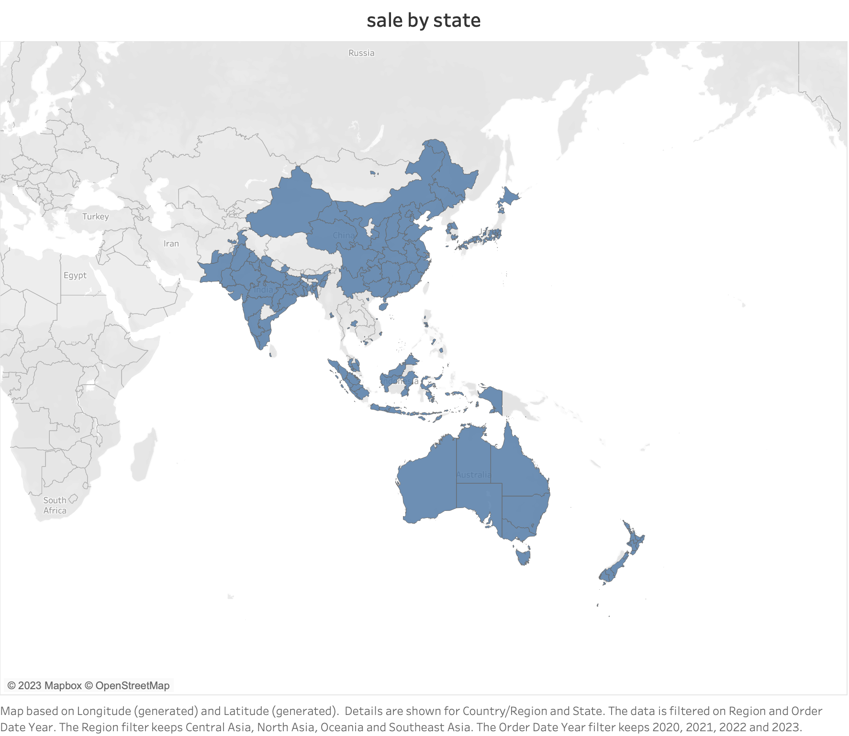

Slide 3
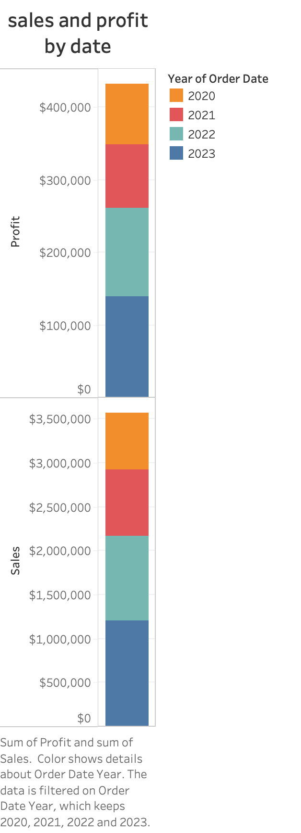

Slide 4
